Slide 1
Introduction

Slide 2

ALGEBRIC EXPRESSION
a + 4ab – 3c + 7
a + 4ab – 3c + 7
a + 4ab – 3c + 7
a + 4ab – 3c + 7
a + 4ab – 3c + 7
a + 4ab – 3c + 7
a + 4ab – 3c + 7
Pronumeral – a symbol or letter which takes the place of a number or a variable
Variable – a quantity which can represent different values
Coefficient – the number which appears before a pronumeral within the same term
Term – a number and one (or more) pronumeral multiplied together or just a number
Constant – a term with no pronumeral

Slide 3
Solving Equations

Slide 4

Equations
s = ut + $\frac{1}{2}$ at²
$$A=πr^{2}$$
I = PRT

Slide 5





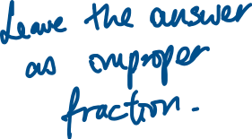
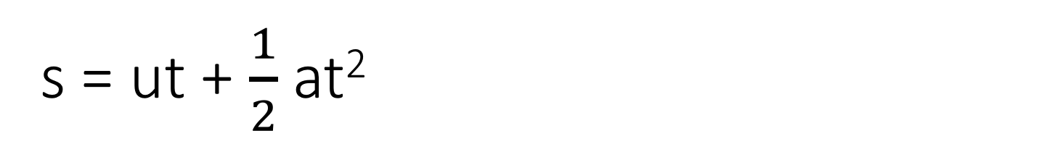
s = ut + $\frac{1}{2}$ at²
Given s = 62, t = 3 and a = 10, find u.

Slide 6


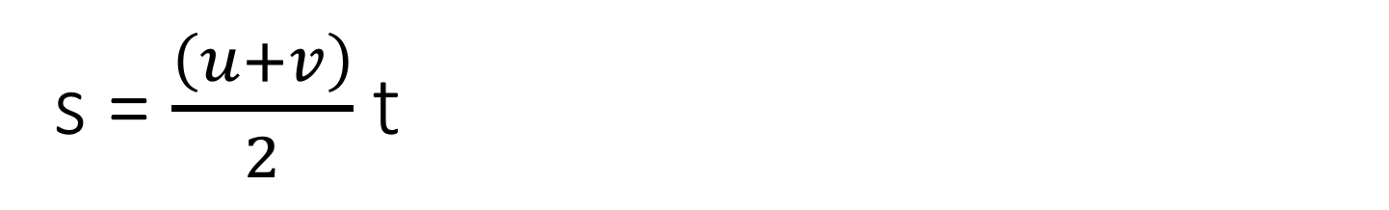





s = $\frac{\left(u+v\right)}{2}$ t
Find t given s = 35, u = 10, v =4

Slide 7



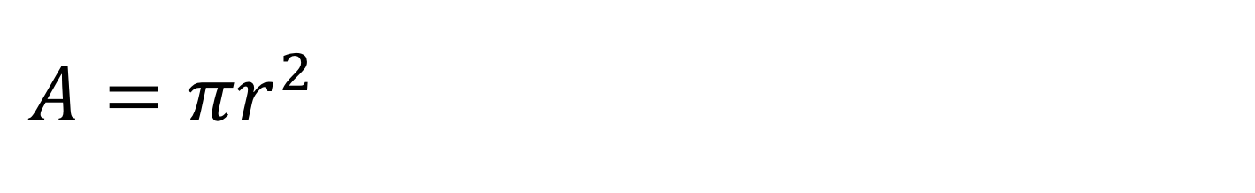




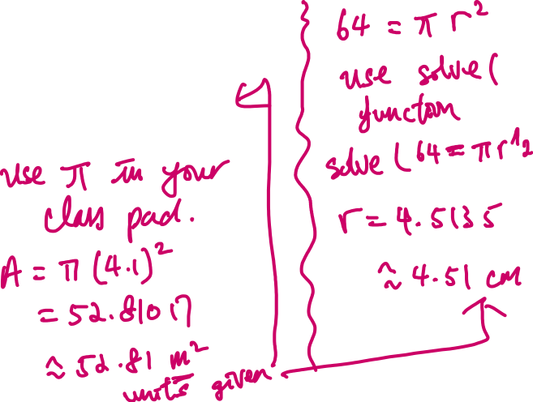
$$A=πr^{2}$$
Find A when r = 4.1 m
Find r when A = 64 cm²

Slide 8
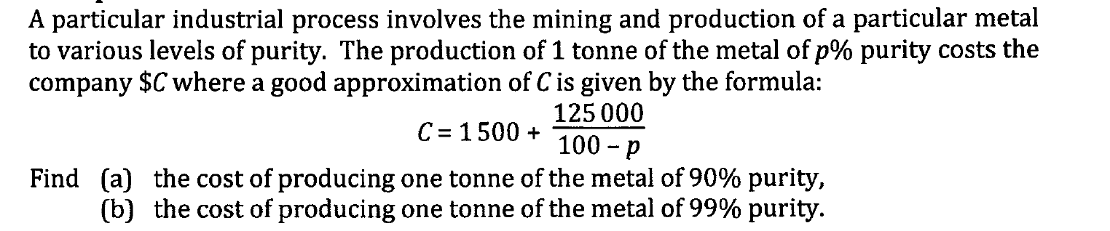






Slide 9
